Slide 1


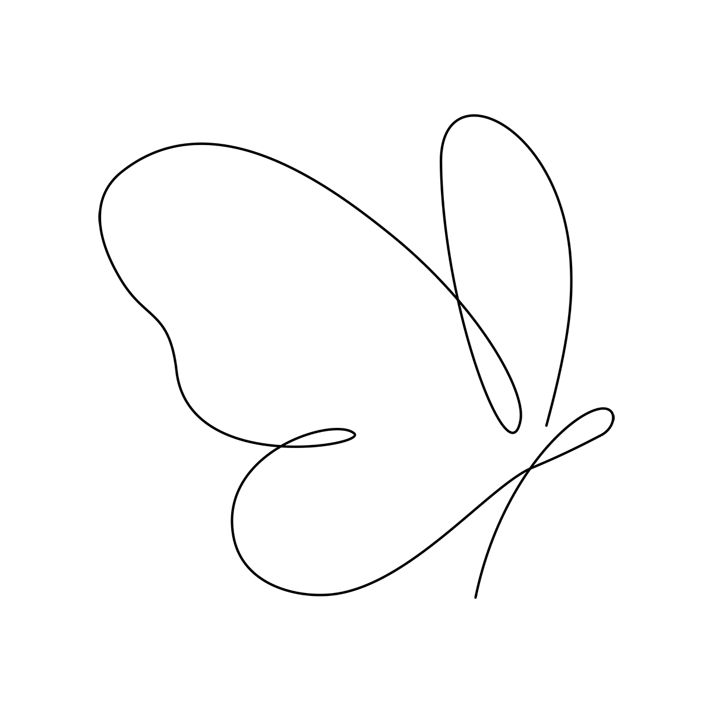
Butt rfly effect
20301

Slide 2
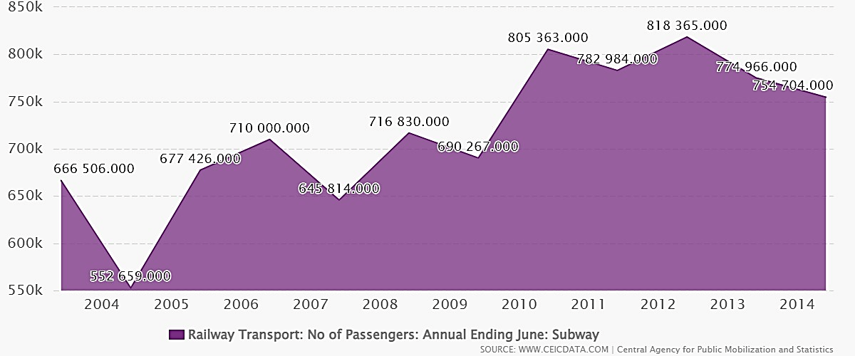
Introduction:
Alternative energy challenges in Egypt
Previous solutions related to our solution
Our chosen solution and how it works
How the solution matches the design requirements

Slide 3
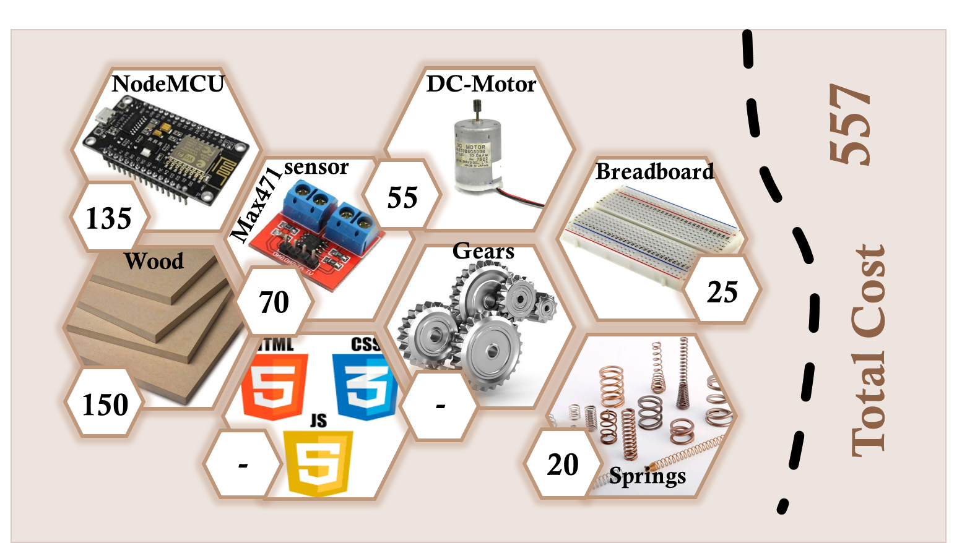
Materials:

Slide 4
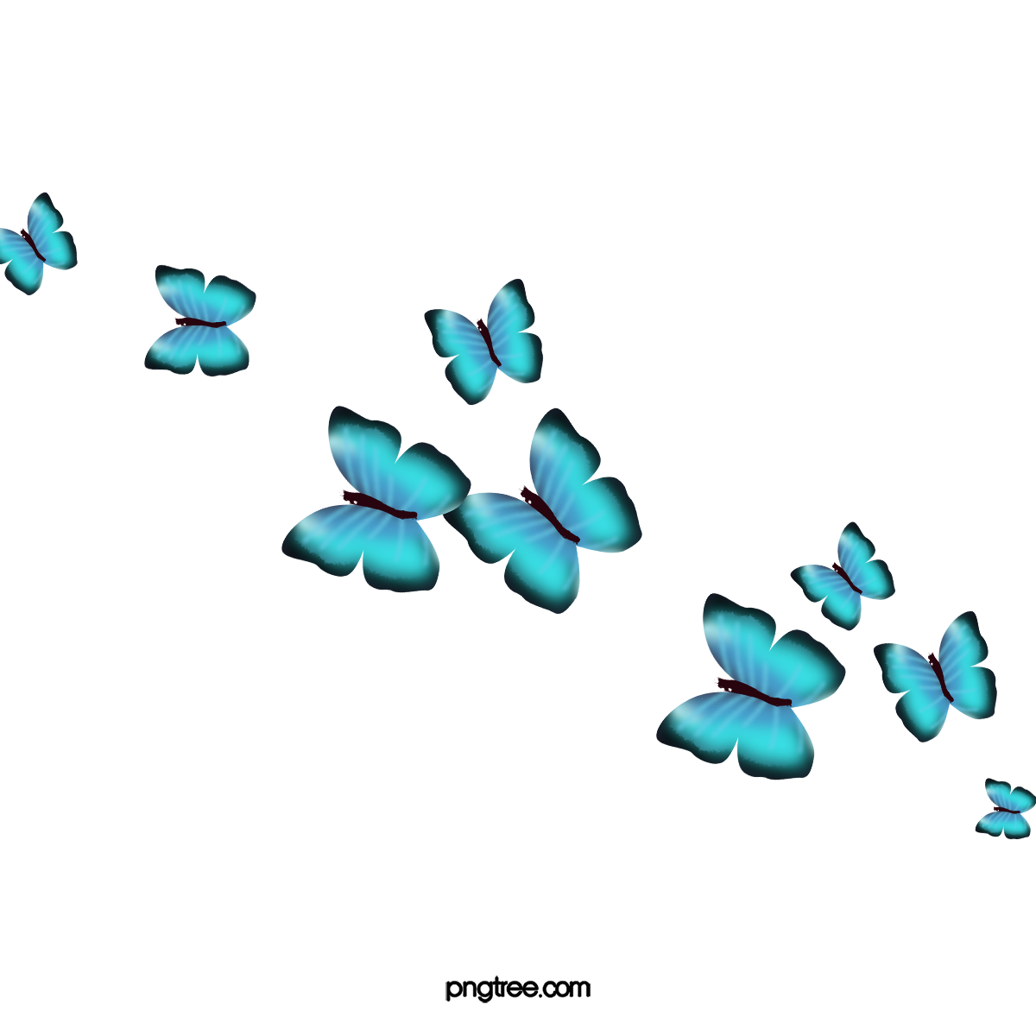
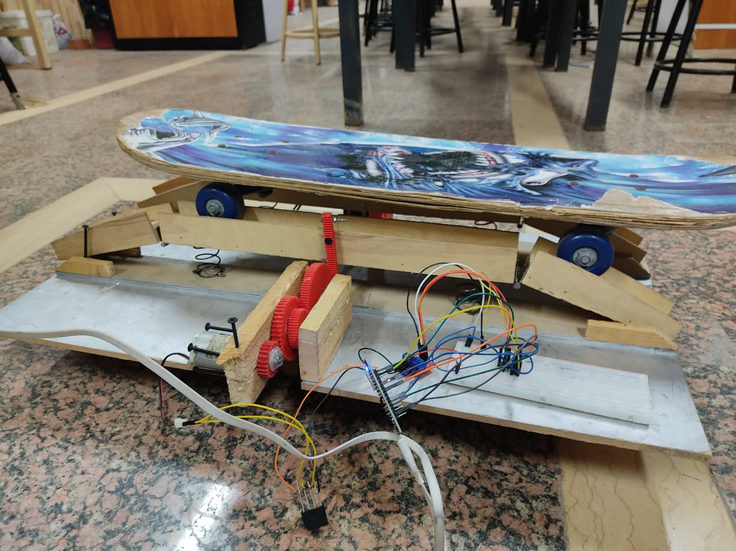
Methods
2d sketch then 3d simulation.
Rack and gear system to gear up the speed.
A Combination of springs to move up and down.
A DC generator and stepper motor (Working as generator).

Slide 5
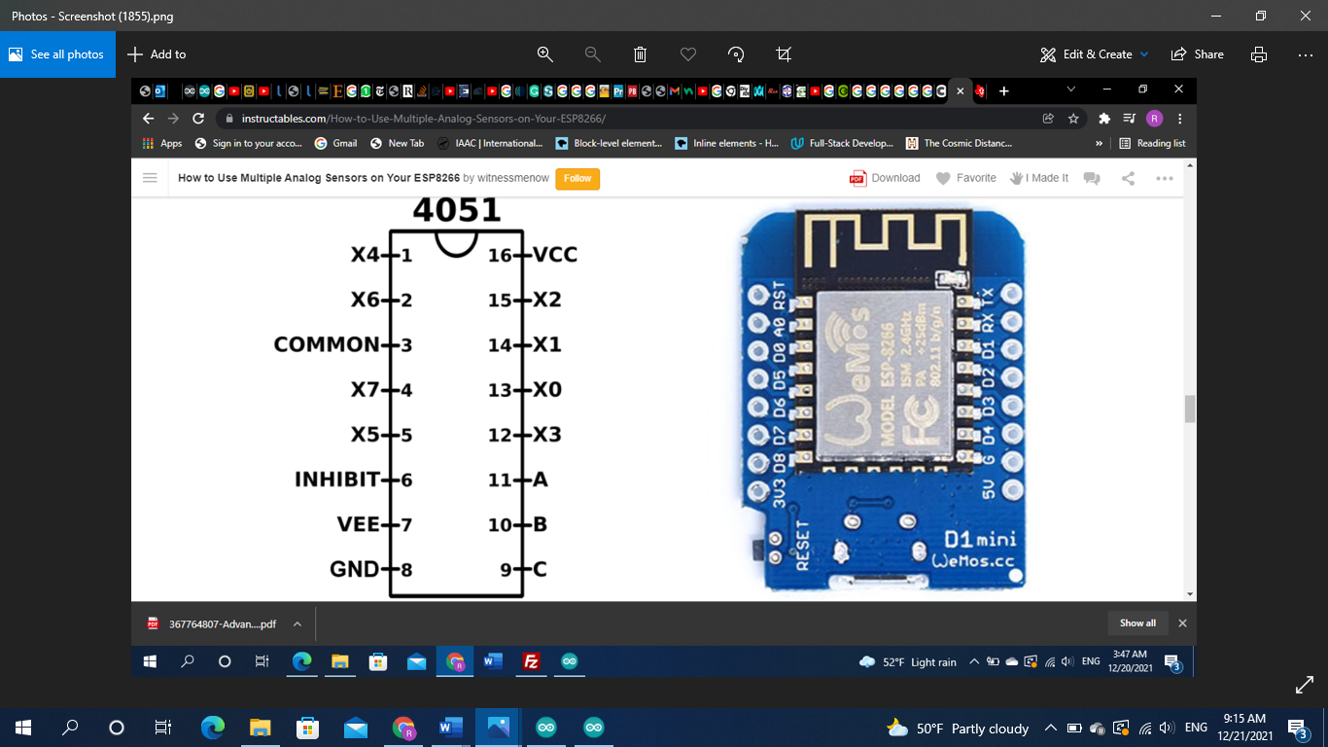
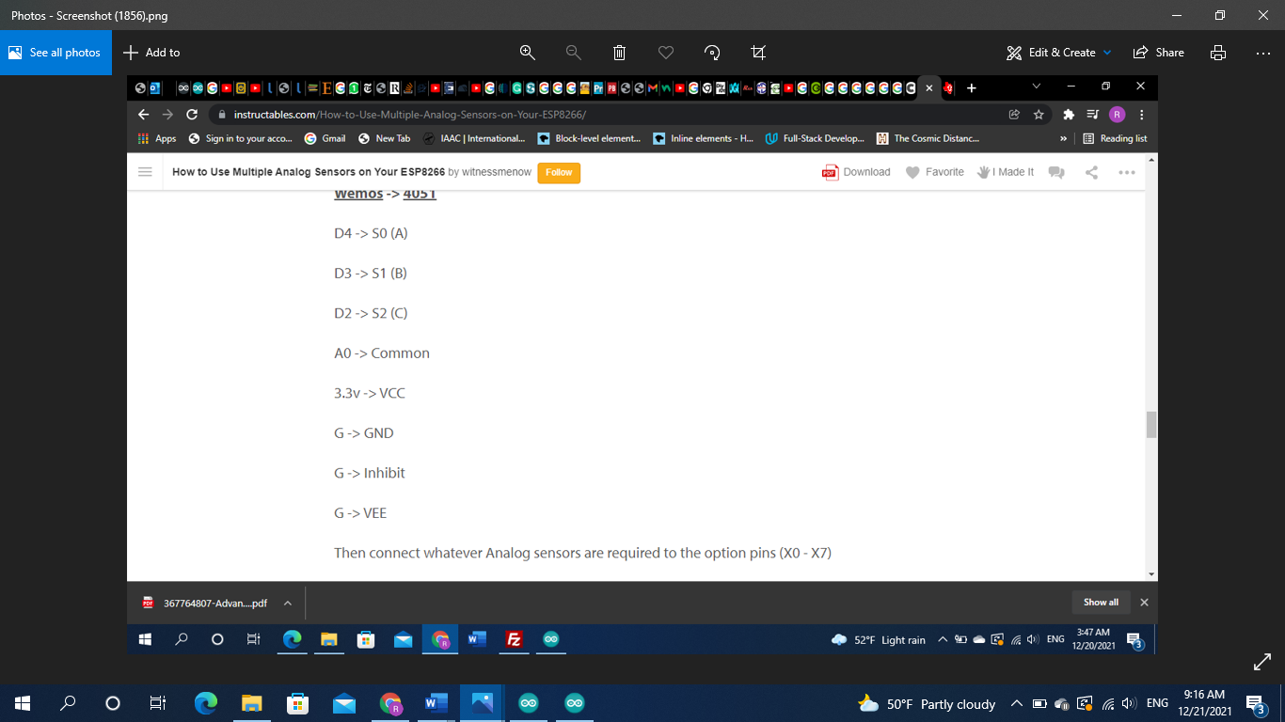
Electronics:
Usage of multiplexer.
NodeMCU and how it works.
Voltage-current senor (Max-471)
Bridge and breadboard connections.

Slide 6
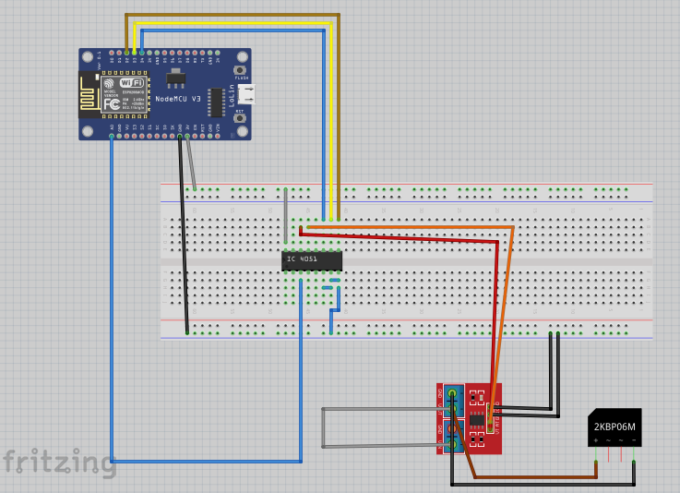
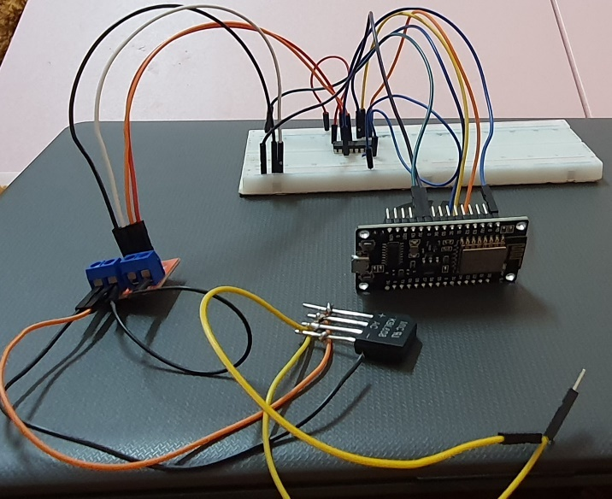
Electronics:

Slide 7
Methods: Website

Slide 8
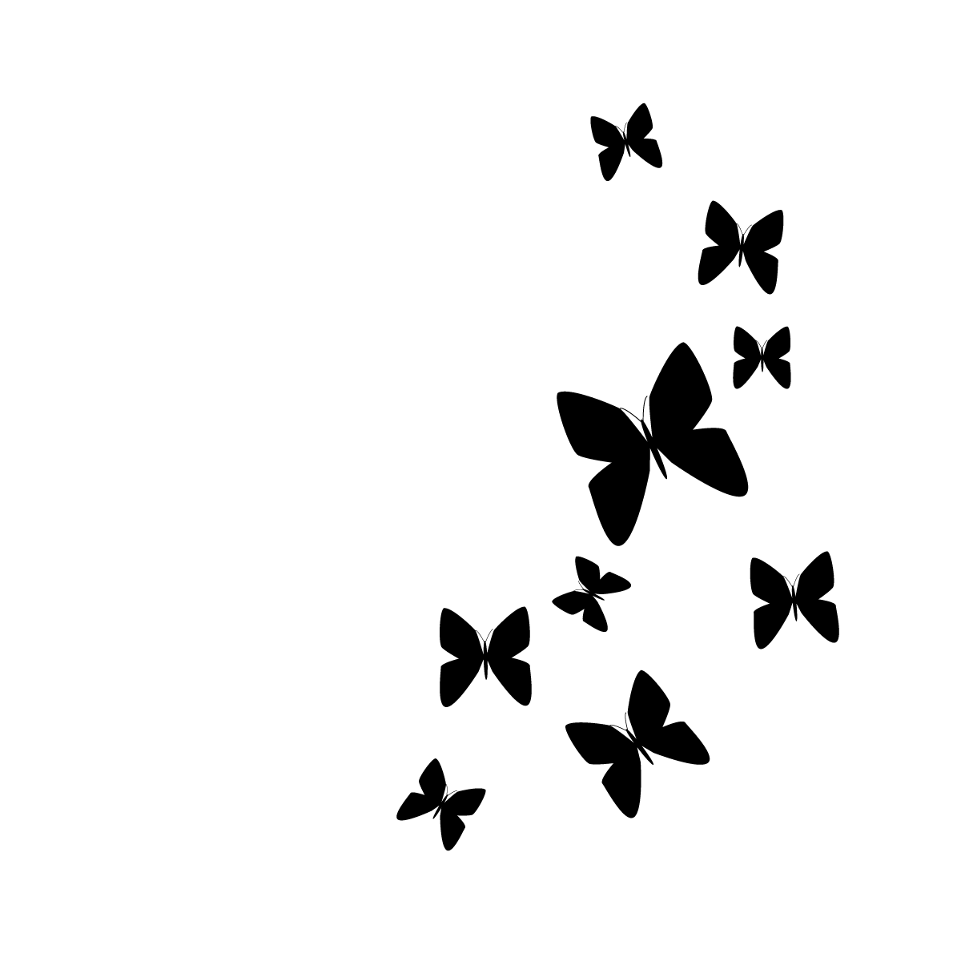
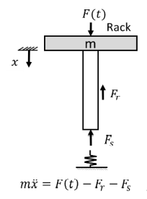
Analysis: Springs
𝐹𝑠 = -kX
𝐹𝑠 = restoring spring force
K = Hooke’s constant
X = Displacement
m 𝑥̈= F(t) − 𝐹𝑠
m 𝑥̈= 𝐹𝑛𝑒𝑡 (Net force)
F(t) = The force the load exerts

Slide 9
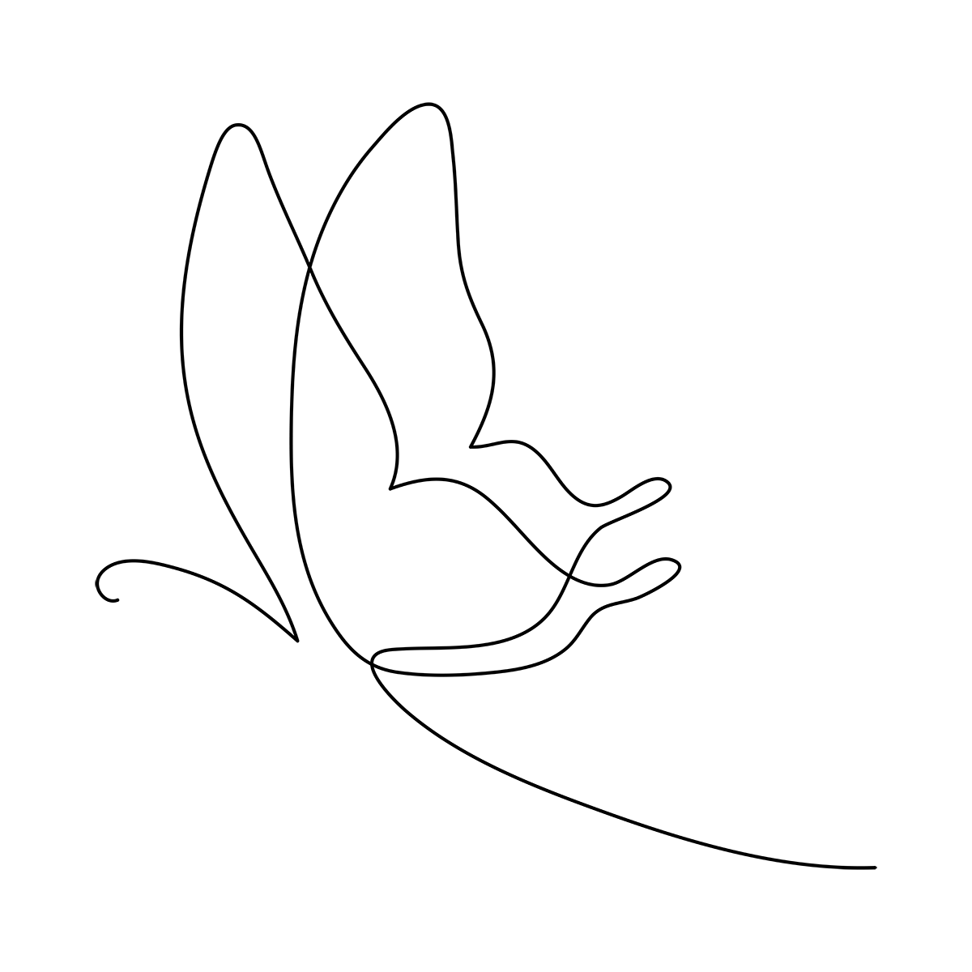
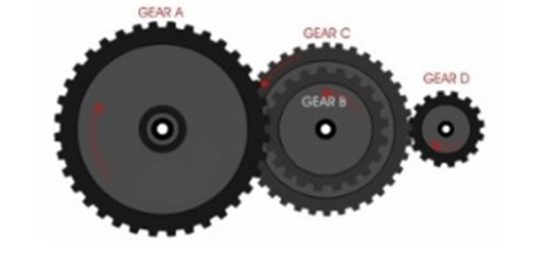
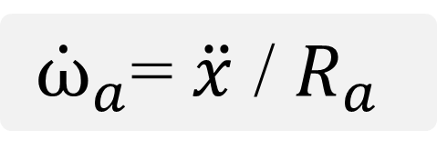
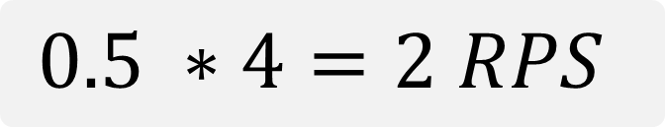
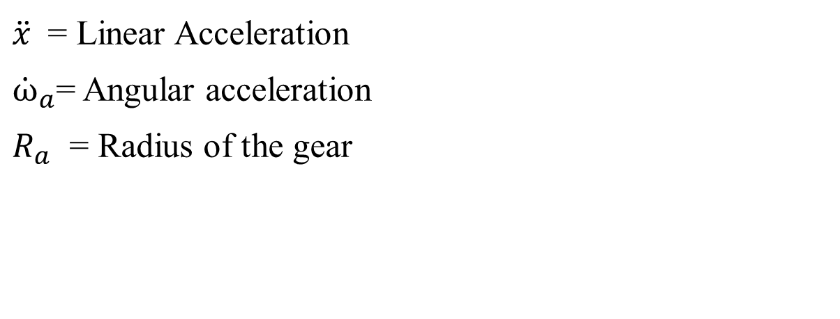
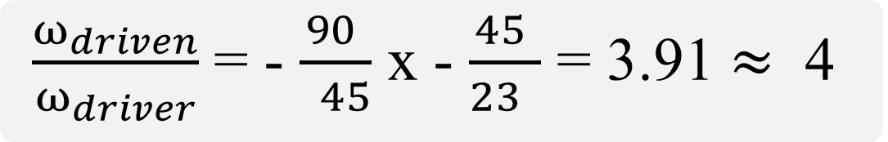
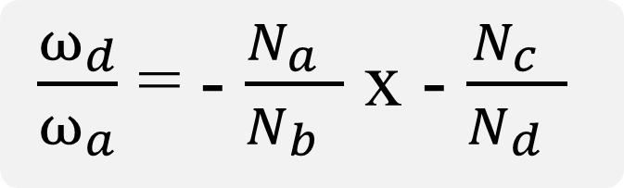
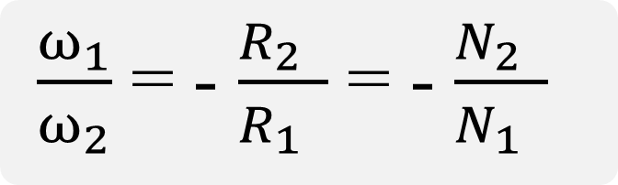
Analysis: Gears
$\frac{ω_{1}}{ω_{2}}$ = - $\frac{R_{2} }{R_{1} }$ = - $\frac{N_{2} }{N_{1} }$
${\dot{ω}}_{a}$= $\ddot{x}$ / $R_{a}$
$\ddot{x}$ = Linear Acceleration
${\dot{ω}}_{a}$= Angular acceleration
$R_{a}$ = Radius of the gear
$\frac{ω_{d}}{ω_{a}}$ = - $\frac{N_{a} }{N_{b} }$ x - $\frac{N_{c} }{N_{d} }$
$\frac{ω_{driven}}{ω_{driver}}$ = - $\frac{90 }{ 45}$ x - $\frac{45 }{23 }$ = 3.91 $≈$ 4
$0.5 ∗4=2 RPS$

Slide 10
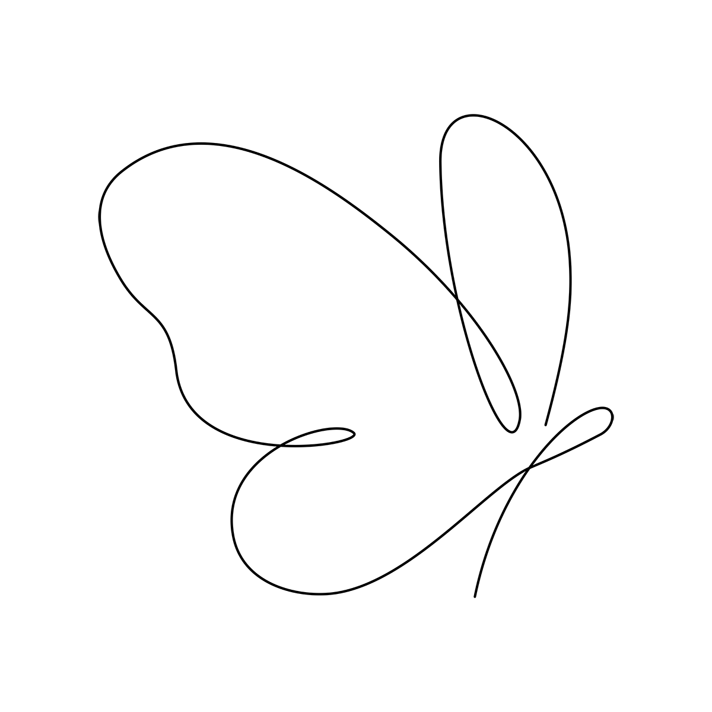
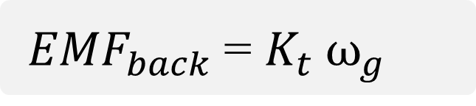
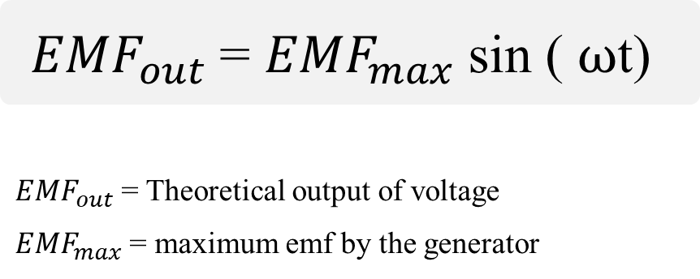
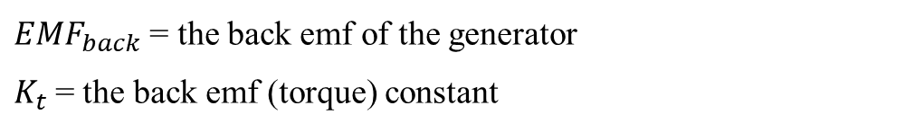
Analysis: Generator
${EMF}_{out}$ = ${EMF}_{max}$ sin ( $ω$t)
${EMF}_{out}$ = Theoretical output of voltage
${EMF}_{max}$ = maximum emf by the generator
Next ➔ Achieving design requirements
${EMF}_{back}$ = $K_{t} ω_{g}$
${EMF}_{back}$ = the back emf of the generator
$K_{t}$= the back emf (torque) constant

Slide 11
Design Requirements:
Ensuring maintenance and consistency.
Resulted power output
Applicability on large scale.
Using communication and technology.

Slide 12
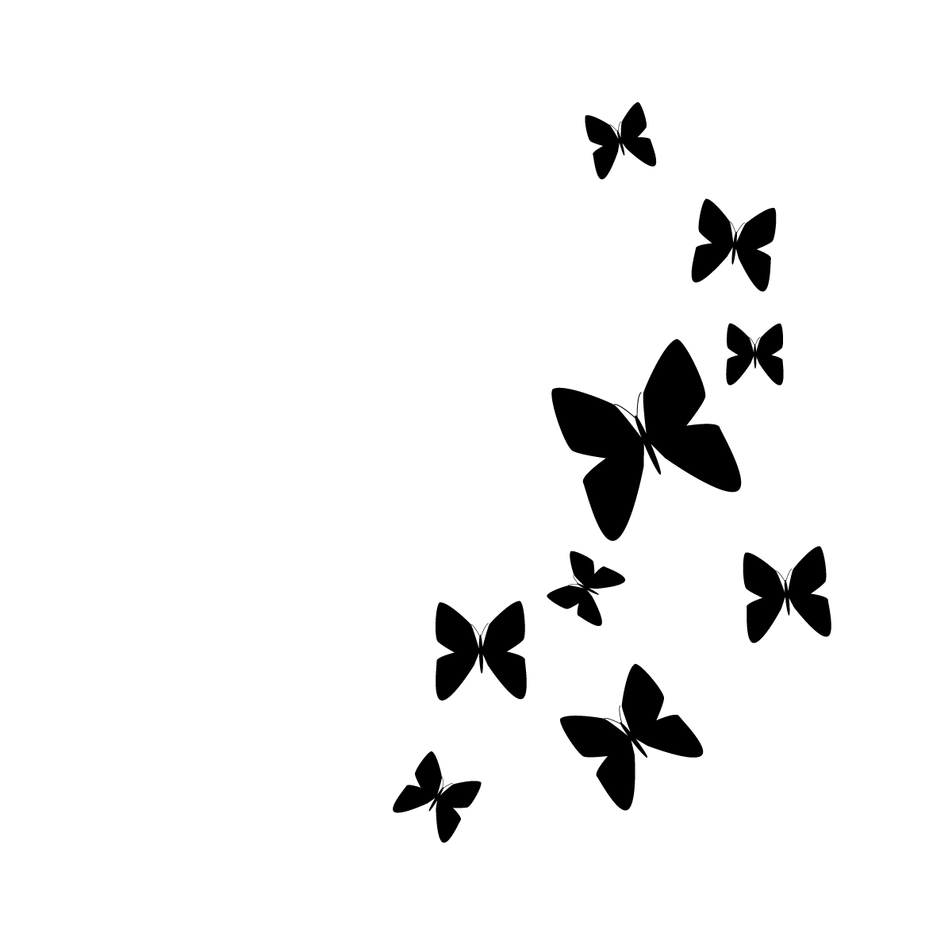
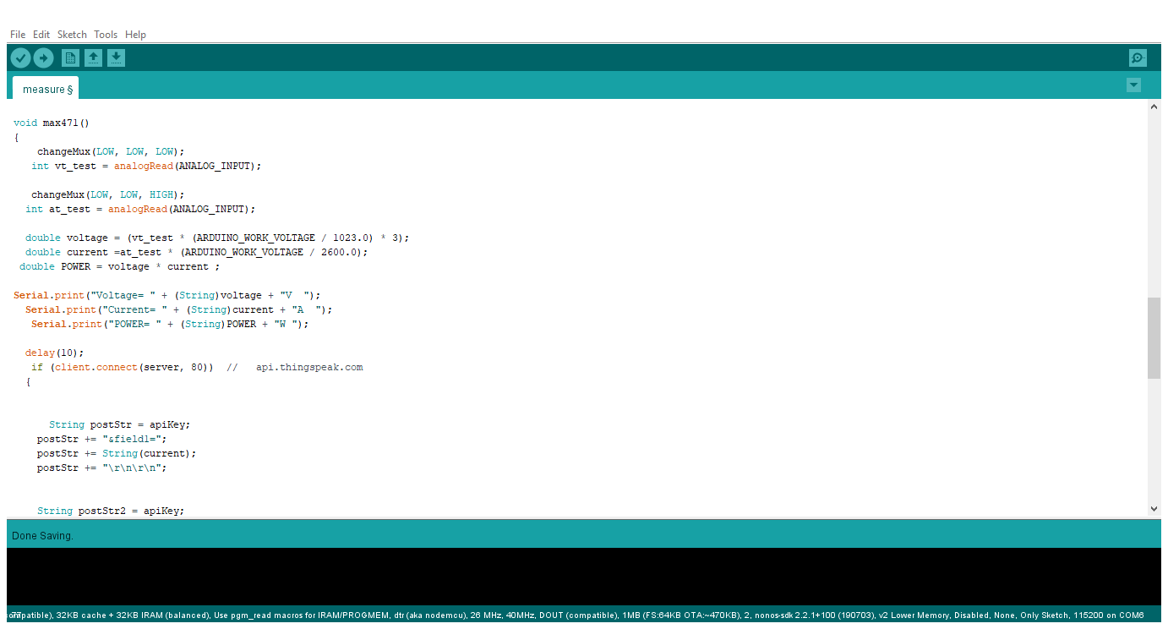
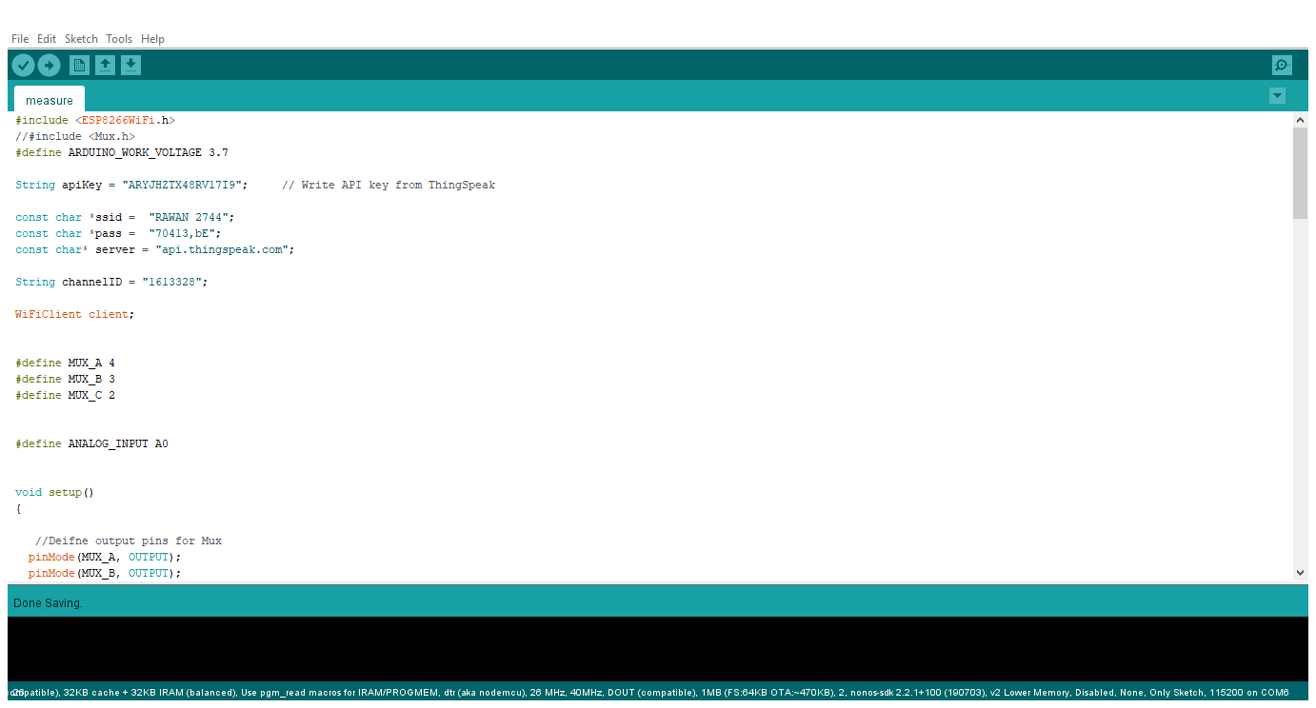
Arduino code:

Slide 13
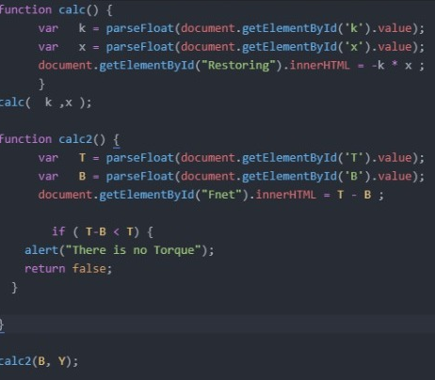
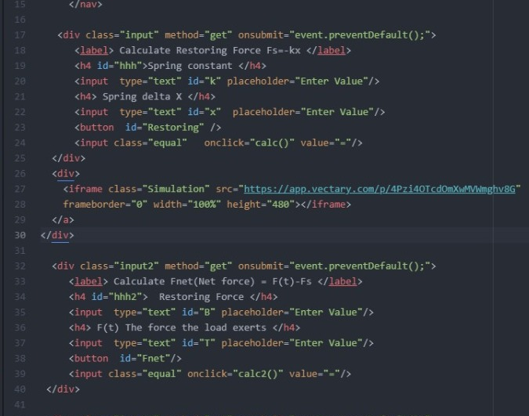
Website code:

Slide 14
Test plan:

Slide 15
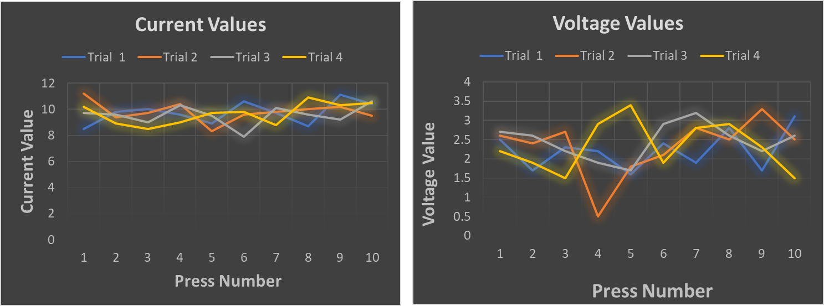
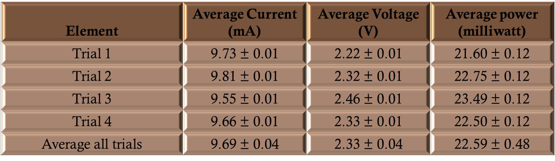
Results:

Slide 16
Conclusion
Utilizing every day's motion
Designing and testing a model
Connect it with the website.
Vertical force and rotation motion

Slide 17
Recommendations:
Using dielectric elastomers deformation as an alternative for springs.
Creating controlling systems to manage the current flow.
A Combination of springs to move up and down.
Using better materials for gears. Due to high strength, and toughness.

Slide 18


